Slide 1
New Mexico Youth Soccer Association
Girls Recreational Coach
of the Year!
Victoria Bonilla

Slide 2
New Mexico Youth Soccer Association
Boys Recreational Coach
of the Year!
Jacob Gandarilla

Slide 3
New Mexico Youth Soccer Association
Girls Competitive Coach
of the Year!
Olivia Carrasco

Slide 4
New Mexico Youth Soccer Association
Boys Competitive Coach of the Year!
Samual Huerta

Slide 5
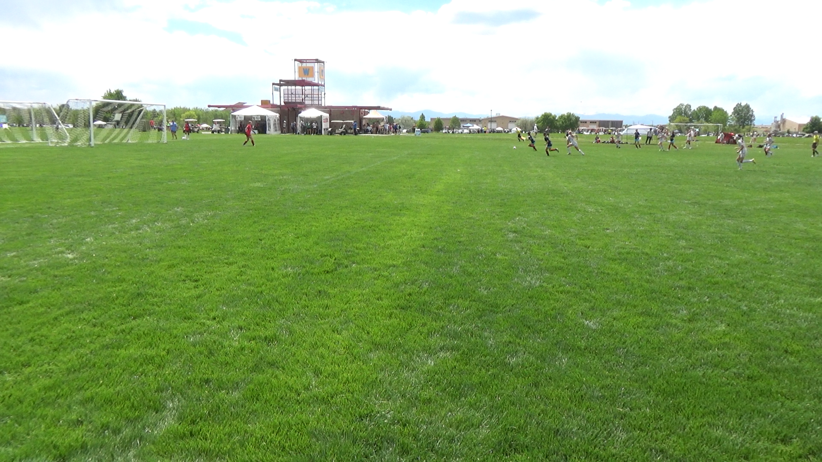
Save of the Year-Hailey Anglin

Slide 6

Goal of the Year – Luis Torres

Slide 7

Young Male Referee of the Year!
Michael
Brinton

Slide 8

Young Male Referee of the Year
Axton Pollard

Slide 9

Young Female Referee of the Year
Eleanor Hynson

Slide 10

Young Female Referee of the Year
Shyla Soffera

