Slide 1
WELCOME!
2022 West/Midwest
TOPSoccer Symposium
Dave Robinson
drobinson@usyouthsoccer.org
941-704-5470 mobile

Slide 2
THANK YOU FOR COMING!
Thanks to New Mexico Youth Soccer Association for ‘answering the call’
Executive Director Gloria Faber
President Pat Switzer
Technical Director (and Committee member) Rick Flores
Thanks to Committee members Sandy Castillo, Shawn Danhouser
Thanks to USYS Board of Directors (and Committee Liaison Thomas Sowinski) for funding the Symposium, including travel and hotel for one participant from each state association
Thanks to USYS President Skip Gilbert, Office Liaison Tom Condone, and staff

Slide 3
MAKE THE MOST OF THE SYMPOSIUM
Get re-acquainted with old friends!
Meet new friends and colleagues!
Ask questions and seek guidance!
Share your best practices!
My #1 Goal: More programs and more participants! (more later)

Slide 4
CRITICAL REQUIREMENTS FOR ALL TOPSOCCER PROGRAMS AND STATE ASSOCIATIONS
Safety - physical, mental/emotional - follow your state guidelines
SafeSport
CDC concussion
Registration - all players involved with your programs
From one-day events to entire seasons
1:4 ratio: for every player, there is a Buddy, parents greatly impacted!

Slide 5


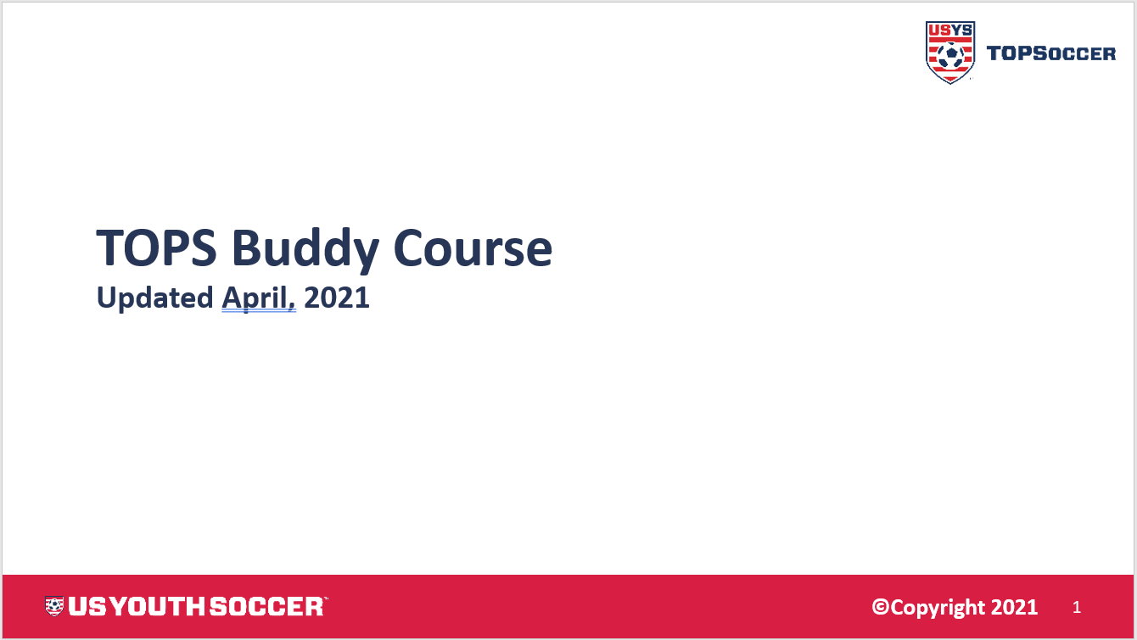
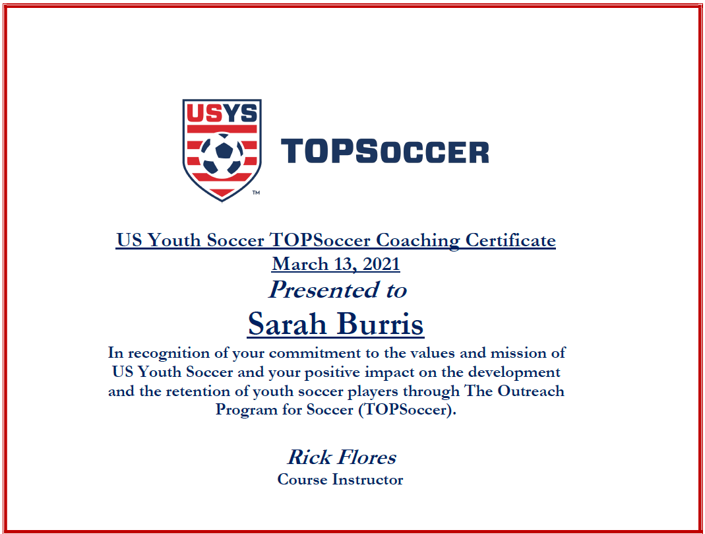
CLARIFY/CONFIRM
Coaching Certification Course
47 slides
Updated branding
English and Spanish language
Buddy Course
22 slides
Updated branding
English and Spanish language
Certificate

Slide 6
AGENDA HIGHLIGHTS
Train the Trainer
Fall 2021 Zoom action item
Bringing structure and standards to the Coaching Certificate Course
Need to refine, standardize, and roll-out nationally – Rick’s leadership
Industry Professional Sessions – upcoming Zoom speaker?
Idea Sharing with AYSO – we are a learning organization

Slide 7
PROGRAM AND PLAYER GROWTH BEGINS WITH SUPPORT
Grant programs
Fall 2021 Grant program distributed close to $100,000
Quarterly ‘Zooms’
Making sure collaboration like this is not just an annual event
Sharing information and updates, best practices – feedback!
Holding the Committee accountable for helping you be successful
Online learning modules
Coming soon to a laptop near you

Slide 8
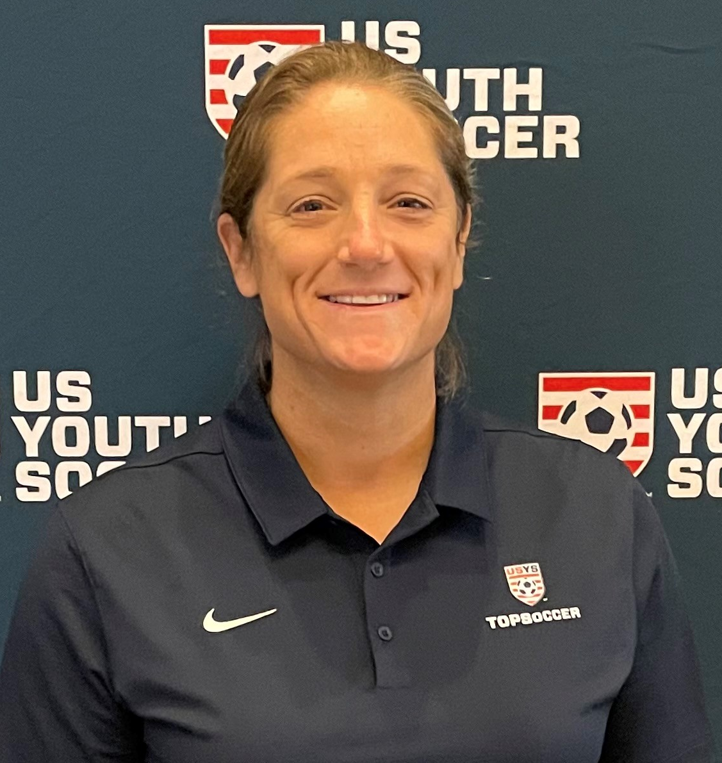
PROGRAM AND PLAYER GROWTH CONTINUES WITH AWARENESS
Who’s gotten that call or email about that ‘TOP’ soccer program?
Shout out to Committee member Shannan Hartinger
Our marketing idea and execution clearinghouse
Shout out to USYS staff Jade Parrish
Our new ‘one-stop solution’ for TOPSoccer support
Look for enhanced marketing and promotional activity
Social media - Autism Acceptance Month, as a start
Newsletter - regular features - history of TOPSoccer
Website - make it more useful, better resource
Video - ‘explainer’ - in the planning stages!

Slide 9
PROGRAM AND PLAYER GROWTH MAXIMIZES WITH MARKETING
How do we reach the millions of players and parents who are not ‘soccer’ people?
Medical professionals (pediatricians, therapists)
Educators
Other disability sports organizations
Celebrities
Sponsors
We are OPEN to ideas and implementers!

Slide 10
COMMITTEE OPENING – Midwest Regional Chair
Shawn Danhouser has announced an intention to retire
Obviously big shoes to fill, lots of passion, commitment – he will be missed!
Interested parties should email me: drobinson@usyouthsoccer.com
Deadline to contact me with interest: April 15
I will email interested parties:
Formal position description to review and commit to
Several questions to respond to in regards to interest, goals, strengths

Slide 11
THANKS FOR ALL THAT YOU ARE DOING!
We will continue to support you as we move forward
Events
  Regional Championships
  National Championships (July 23, Orlando)
Future Symposiums
  2023 National, Kansas City
Dave Robinson
drobinson@usyouthsoccer.org
941-704-5470 mobile

